Slide 1


Project Assessment – 1
Fake News Detection
Presented by
Chris Mathew – AV.EN.U4CSE22213
G Naga Vamshi – AV.EN.U4CSE22216
Under the Supervision of
Mr. Dontha MadhuSudhana Rao (Asst. Prof)
Department of Computer Science
Amrita Vishwa Vidyapeetham, Amaravati

Slide 2





Introduction
1. Definition of Fake News : Deliberate spread of false or misleading information to deceive or manipulate public opinion.
2. Impact of Fake News : - Spread: Social media accelerates the dissemination of fake news.
- Consequences: Causes political instability, erosion of journalistic trust, and potential violence.
- Viral Nature: Quickly goes viral, especially during elections, health crises, and disasters.
3. Detection Challenges
- Complexity: Mix of truth and misinformation complicates identification.
- Traditional Methods: Fact-checking struggles with fake news volume and sophistication.
- Global Reach: Affects millions, with media literacy and regulation influencing vulnerability.
4. Effects on Society
- Misleads the public and reinforces biases, leading to polarized communities.
5. Role of Machine Learning
- Solution: Machine learning aids in detecting patterns and linguistic cues in fake news.
- Automation: Models enable automated, timely detection to prevent harm.
6. Future Goals
- NLP Advancements: Enhance detection with emerging natural language processing.
- 2025 Objective: Develop systems to filter false narratives and promote trustworthy journalism.

Slide 3
Literature Survey
No | Title | Author(s) | Technique Used | Drawback
1 | Fake News Detection Using Machine Learning Algorithms | Shu et al. (2020) | SVM, Naive Bayes (Accuracy: 79%) | Limited dataset, biased towards specific news categories
2 | Hybrid Approach for Fake News Detection | Zhou and Zafarani (2020) | Ensemble learning combining logistic regression, SVM, and neural networks | Did not address bias in the dataset
3 | Comparative Study of Machine Learning Techniques for Fake News Detection | Singh and Sharma (2021) | Random Forest (best performance), SVM, and XGBoost | Limited analysis on misclassification of borderline cases
4 | Automated Fake News Detection Using Neural Networks | Wang et al. (2021) | LSTM-based Recurrent Neural Networks (RNN) | Computationally expensive, overfitting issues

Slide 4
No | Title | Author(s) | Technique Used | Drawback
5 | Fake News Detection with Ensemble Methods | Zubiaga et al. (2022) | Random Forest, Gradient Boosting (F1-score: 0.85) | Ensemble models are less interpretable
6 | Identifying Fake News Using Natural Language Processing | Kumar and Gupta (2023) | BERT model with fine-tuning (AUC: 0.93) | Does not consider multimodal content (images, videos)

Slide 5
Summary (Based on Literature Survey)
Shu et al. (2020):
Techniques Used: Support Vector Machines (SVM) and Naive Bayes.
Performance: Achieved an accuracy of 79%.
Wang et al. (2021):
Techniques Used: Deep learning models, specifically LSTM-based Recurrent Neural Networks (RNN).
Performance: Offered promising results but had high computational costs.
Zubiaga et al. (2022):
Techniques Used: Ensemble methods such as Random Forest and Gradient Boosting.
Performance: Achieved an F1-score of 0.85; however, models lacked interpretability.
Kumar and Gupta (2023):
Techniques Used: Fine-tuned a BERT model for natural language processing.
Performance: Obtained an AUC of 0.93, but did not address multimodal content detection (e.g., images and videos).
Overall Insights:
The survey highlights advancements in fake news detection methods.
Emphasizes strengths and limitations of current models.
Stresses the need for comprehensive approaches that integrate both text and multimedia content

Slide 6
Research Gap
1. Limitations of Current Approaches
Text-Based Detection Focus: Most machine learning models for fake news detection, such as SVM, Naive Bayes, and Random Forest, primarily focus on text analysis, neglecting the potential of multimodal content (e.g., images, videos) in identifying disinformation.
Static Datasets: Current studies often use static datasets, limiting the models' ability to adapt to evolving disinformation tactics and real-time events, thereby reducing detection effectiveness.
2. Challenges with Existing Models
Computational Expense: Models like Random Forest, Gradient Boosting, and LSTM-based Recurrent Neural Networks, while effective, often incur high computational costs, making them less accessible.
Overfitting: These models can be prone to overfitting, performing well on training data but struggling to generalize to new, unseen data.
Lack of Interpretability: The complexity of ensemble models can hinder interpretability, making it difficult for non-expert users to understand results and for developers to fine-tune the models.
3. Recommendations for Future Research
Integration of Multimodal Data: Future research should integrate multimodal data sources, such as images, videos, and text, to enhance detection accuracy and relevance.
Prioritizing Explainability: Developing models that emphasize explainability is essential for fostering user trust and facilitating better model tuning.
Expanding Datasets: Expanding datasets to include a diverse range of news categories and disinformation strategies is crucial for improving the generalizability and robustness of detection models.

Slide 7
Motivation
Fake news poses a significant challenge to public opinion and trust in media, particularly during the COVID-19 pandemic, where disinformation has led to increased vaccine hesitancy. The rapid spread of misinformation on social media undermines public health efforts and complicates vaccination campaigns. Traditional fact-checking methods often struggle to keep up, highlighting the need for advanced solutions. Machine learning techniques, such as Neural Networks and Natural Language Processing (NLP) models, can enhance fake news detection accuracy by 10-20%. By automating the identification of misleading claims about vaccines, these models enable faster and more reliable responses, ultimately reducing the societal harm caused by false information and supporting public health initiatives.
Problem Statement
To develop a machine learning model that accurately detects fake news by analyzing textual content, linguistic patterns, and contextual features.

Slide 8
Dataset Description
WELFake consists of 72,134 entries of news articles, categorized into 35,028 real news items and 37,106 fake news items. The dataset was created by merging four well-known news sources (Kaggle, McIntire, Reuters, BuzzFeed Political) to enhance the diversity of text data and mitigate classifier overfitting.
The dataset contains four columns:
Serial Number: Unique identifier for each article (starting from 0).
Title: The headline of the news article.
Text: The content of the news article.
Label: Class label indicating article type (0 = fake, 1 = real).
There are 78,098 total entries in the CSV file, but only 72,134 entries are utilized in the analysis. The dataset is beneficial for training models to distinguish between fake and real news, addressing issues of misinformation in digital media.

Slide 9
Techniques Used for Preprocessing
Data Cleaning: Removed punctuation, special characters, and stopwords to reduce noise in the text data. Handled missing values by filling or removing entries to ensure data consistency.
Feature Engineering: Applied vectorization techniques, including Count Vectorizer, to convert text data into numerical features suitable for model training. Additionally, created new features based on n-grams to capture phrases and contextual patterns within the text. Extracted custom features, such as word frequency, text length, and the presence of specific keywords
Handling Imbalanced Classes: Used class weights in the model to address class imbalance, giving higher importance to the minority class to reduce bias in predictions.

Slide 10
Methodology
Data Collection: Utilized the WELFake dataset, which contains labeled news articles classified as either "fake" or "real," to train and evaluate the fake news detection models.
Model Selection: Compared several machine learning classifiers, including Logistic Regression, Random Forest, Naive Bayes, and Support Vector Machine (SVM) to identify the best model for fake news detection.
Training and Testing: Split the dataset into training and test sets to evaluate model performance and ensure that results are generalizable.
Evaluation Metrics: Assessed model performance using accuracy and other relevant metrics to determine the best-performing model for the task.

Slide 11
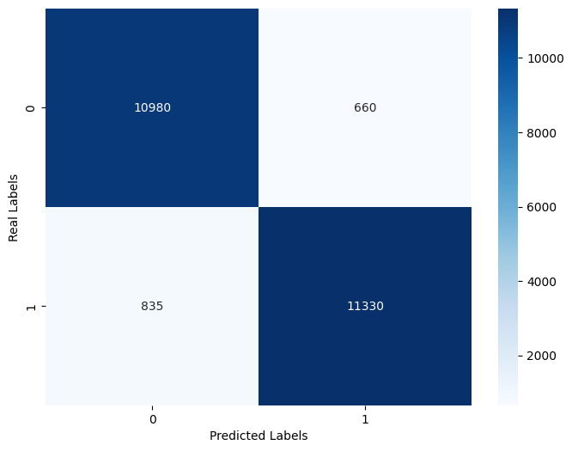
Model Results - Logistic Regression
Accuracy: 94% – The model correctly classified 94% of the test data.
Precision:
Class 0: 93% – Of the instances classified as Class 0, 93% were correctly identified.
Class 1: 94% – Of the instances classified as Class 1, 94% were correctly identified.
Recall:
Class 0: 94% – The model was able to correctly identify 94% of Class 0 instances, indicating high sensitivity.
Class 1: 93% – The model was able to correctly identify 93% of Class 1 instances, indicating high sensitivity.
F1 Score:
Class 0: 94% – This harmonic mean of precision and recall for Class 0 reflects a strong balance between both metrics.
Class 1: 94% – This harmonic mean of precision and recall for Class 1 reflects a strong balance between both metrics.
Overall: The Logistic Regression model demonstrated high accuracy and balanced precision and recall across both classes, making it an effective choice for this classification task.

Slide 12
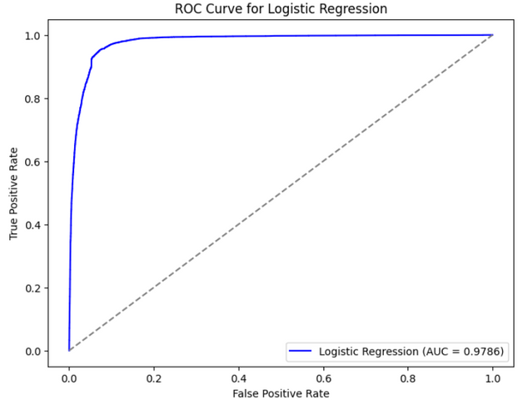
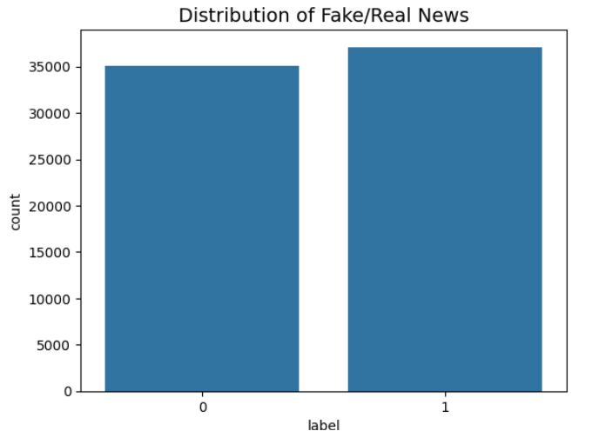

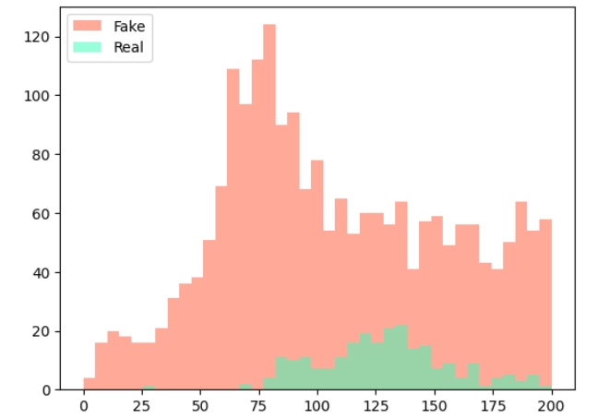
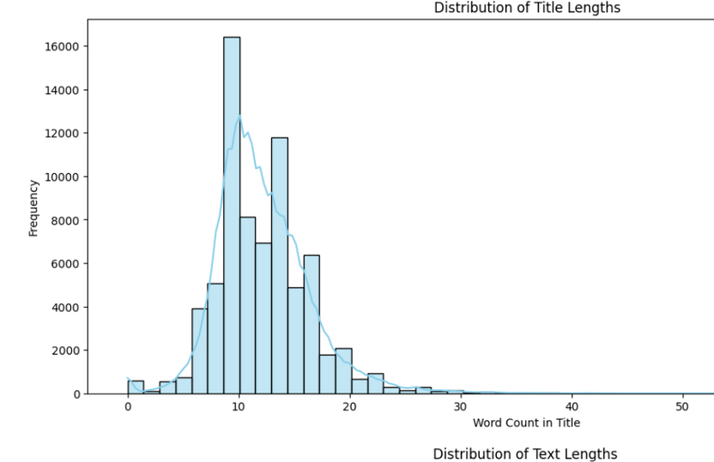
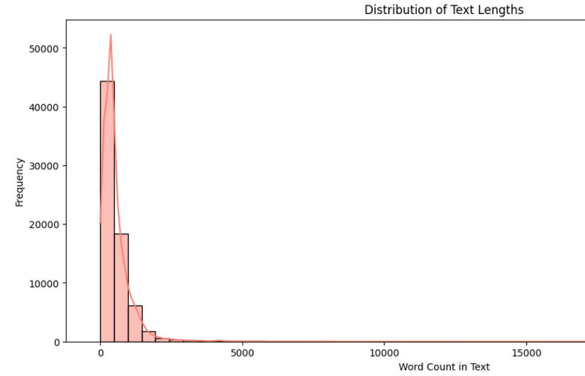
Data Visualization :

Slide 13







Architecture Work-Flow
Proposed Idea
Fake
Real
Data Exploration
Dataset
Classification
News Title
Stopword Removal
Data Cleaning
Vectorization
Model
Data Preprocessing
Model Training and Evaluation
Visualization
Final Results
Select Features(X) and Target(Y)
Training Logistic Regression model
Plot ROC Curve,Histograms
Confusion Matrix and Accuracy for both
Split data into Training and Testing
Train Random Forest classifier
Train Random Forest classifier
Classification report:
Logistic Regression
Standardize numerical features
Predict and Evaluate both the models
Predict and Evaluate both the models
ROC and AOC curve:
Random Forest

Slide 14
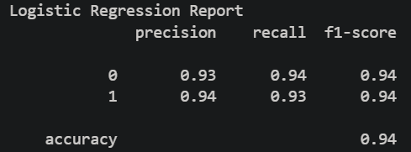
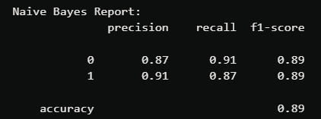
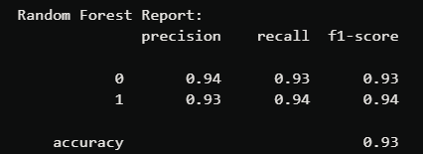
Comparison of Results with Other Models
Our Model
In addition to its higher accuracy (94%), the Logistic Regression model offers better interpretability compared to Random Forest, as it provides clear insights into feature importance through coefficients. Unlike Naive Bayes, which assumes feature independence, Logistic Regression can capture dependencies between features, contributing to its improved performance in this dataset.
Other Models

Slide 15
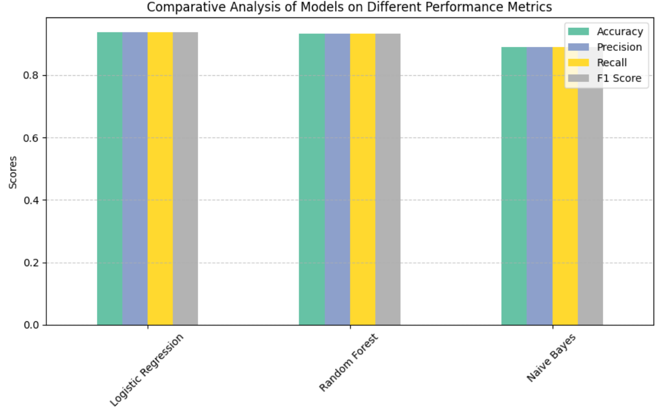

Slide 16
Conclusion
Summary: Successfully detected fake news articles using various machine learning models, with a focus on text classification techniques.
Key Insight: Logistic Regression provided the highest accuracy (94%) and performed slightly better than other models, making it the most reliable for this application.
Future Work: Explore advanced techniques like deep learning (e.g., LSTM, BERT) to capture complex patterns in text, and consider using ensemble methods to further improve classification performance.
Impact: Contributes to reducing the spread of misinformation by providing an effective tool for identifying fake news, supporting fact-checkers, media organizations, and social media platforms.

Slide 17
References
Shahane, S. (2021). Fake News Classification. Kaggle. Retrieved from https://www.kaggle.com/datasets/saurabhshahane/fake-news-classification
TShu, K., et al. (2020). Combating Fake News: A Survey on Identification and Mitigation Techniques. ACM Transactions on Intelligent Systems and Technology (TIST). Retrieved from https://dl.acm.org/doi/10.1145/3402563
Singh, P., & Sharma, A. (2021). Comparative Study of Machine Learning Techniques for Fake News Detection. International Journal of Computer Applications, 975, 8887. Retrieved from https://www.ijcaonline.org/archives/volume975/number8887/110569-2021918001
https://www.researchgate.net/publication/364095999_Fakebuster_Fake_News_Detection_System_Using_Logistic_Regression_Technique_In_Machine_Learning

